Slide 1

Current Liabilities and Contingencies – In-Class

Slide 2
From the Video
Current liabilities are obligations to perform within a year.
Accounts payable are open, informal liabilities usually related to the purchase of inventory from a supplier.
Sales taxes are collected from the customer by the seller of goods and later remitted to the state.

Slide 3
Current liabilities
We cover:
Accounts payable
Sales tax payable
Gift cards
Warranties
Contingencies
Other current liabilities (not exhaustive):
Wages
Payroll taxes
Current portion of long-term debt
Dividends payable
Salaries payable
Unearned revenue

Slide 4
Gift cards
A gift card allows the holder to receive goods or services of a specified value from the issuing company.
When a customer buys a gift card, the company receives cash on issuance → goods/services not delivered yet
Cash (B-A) 100
Unearned revenue – gift cards (B-L) 100

Slide 5
Gift cards
Going forward...
Redemption: When a customer redeems a gift card, company delivers the goods/services → recognize revenue
Unearned revenue – gift cards (B-L) 80
Sales Revenue (I-R) 80
Breakage: Not all gift cards are redeemed. When redemption will not occur → recognize revenue
Unearned revenue – gift cards (B-L) 20
Breakage Revenue (I-R) 20
Notes:
Breakage:
Remote method: estimate amt of breakage and recog when prob. Of redemption is REMOTE.
Proportional method: recognize ratably as actual redemption occurs (pool all gift cards and estimate # breakage and window of usage)

Slide 6
Gift cards
When do we recognize breakage?
When likelihood of redemption is remote
e.g., it’s been two years, let’s get rid of the liability and recognize the revenue.
OR
Ratably while gift cards are redeemed
e.g., a company believes 20% of gift cards won’t be redeemed. When X% of expected gift cards are redeemed, recognize X% of the breakage as revenue.

Slide 7
Why Ratable Breakage?
We owe customers goods or services equal to the value of their cards.
But based on years of experience, we know some cards will never be redeemed — those obligations will never require us to give anything back.
If we don’t reduce that liability gradually, we’d permanently understate revenue and overstate liabilities.
So, we recognize breakage revenue ratably — use the % of EXPECTED redemptions that have ACTUALLY been redeemed already — so the timing of breakage revenue tracks with the actual customer activity, not with a one-time guess.

Slide 8
Ratable Breakage Example
Zany Zoo Corp. sells $1,000 of gift cards in 2020. $700 of gift cards are redeemed in 2020. Of the initial sale, Zany Zoo expects that 80% of the gift cards will be redeemed and 20% will never be redeemed.
Upon Sale:
Cash (B-A) 1,000
Unearned Revenue 1,000
or Gift Card Liability (B-L)

Slide 9
Ratable Breakage Example
Zany Zoo Corp. sells $1,000 of gift cards in 2020. $700 of gift cards are redeemed in 2020. Of the initial sale, Zany Zoo expects that 80% of the gift cards will be redeemed and 20% will never be redeemed.
Upon Redemption:
Unearned Revenue (B-L) 700
Revenue (I-R) 700

Slide 10
Ratable Breakage Example
Zany Zoo Corp. sells $1,000 of gift cards in 2020. $700 of gift cards are redeemed in 2020. Of the initial sale, Zany Zoo expects that 80% of the gift cards will be redeemed and 20% will never be redeemed.
At end of first year (Ratably):
Unearned Revenue (B-L) 175
Revenue (I-R) 175
Expected breakage revenue = $1,000 x 20% = $200
Total expected redemptions = $1,000 x 80% = $800
% Redeemed = $700 / $800 = 87.5%
Breakage Revenue = 87.5% x $200 = $175

Slide 11
Gift cards
One breakage caveat:
Some states consider unredeemed gifts cards to be unclaimed property, require companies to escheat the cash to the state.
Definition: the reversion of property to the state, or (in feudal law) to a lord, on the owner's dying without legal heirs.
Big complication for companies in terms of tracking as well as compliance with different state laws.
However, you need to know the breakage rules for the exams!!
Notes:
Colorado is 5 years unused gets reported as unclaimed property to the state

Slide 12
Go to handout…
Problem #1

Slide 13
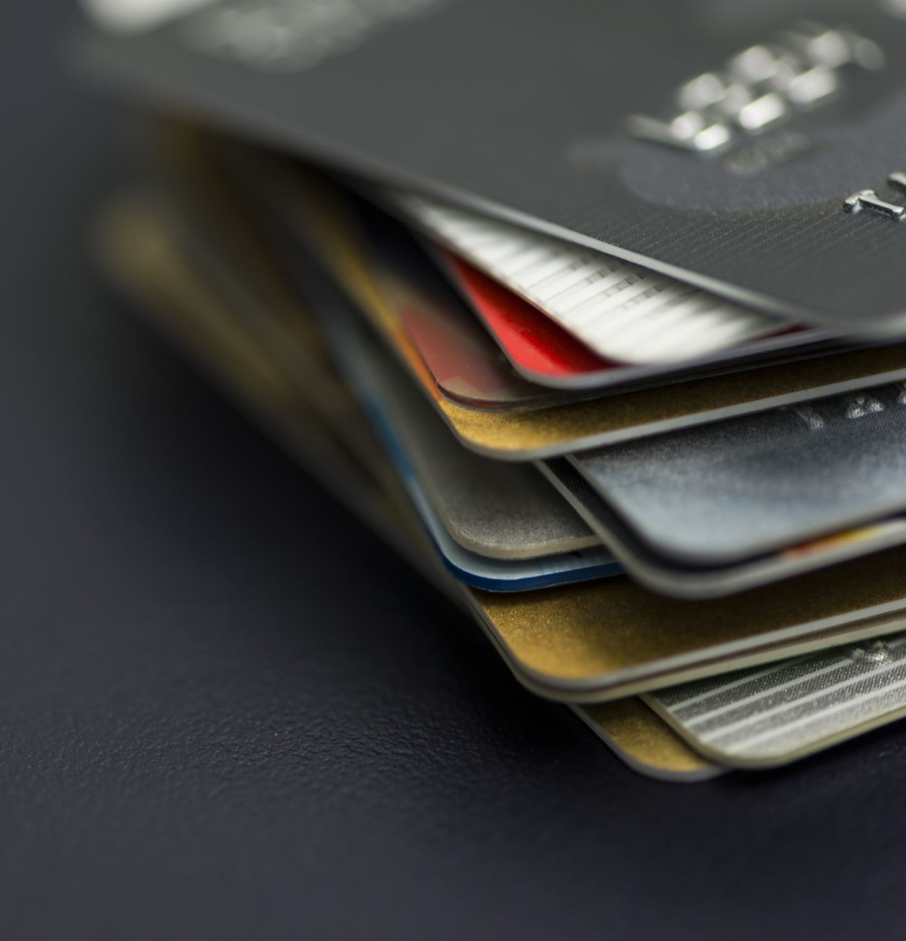
Current liabilities
We cover:
Accounts payable
Sales tax payable
Gift cards
Warranties
Other current liabilities (not exhaustive):
Wages
Payroll taxes
Current portion of long-term debt
Dividends payable
Salaries payable
Unearned revenue

Slide 14
Assurance/Product Warranty
An assurance or product warranty is a promise to repair/replace the good within a certain time. This is different from warranties sold separately from product (service warranty).
When goods are sold with a warranty, estimate the liability & expense at the point of sale :
Warranty expense (I-E) 100
Warranty liability (B-L) 100
If a claim is made, the liability is reversed:
Warranty liability (B-L) 80
Asset/Liability used to fulfill claim (B-A or B-L) 80
If the warranty period expires, eliminate any unused liability:
Warranty liability (B-L) 20
Warranty Expense (I-E) OR Gain (I-R) 20
LOTS of ways warranty claims can be made. Cash paid. Inventory Given. Work done and Wage Payable recorded. Take this as it comes!!!
Notes:
3 journal entries at sale:
Revenue and receivable/cash (whatever is used to fulfill warranty claim)
COGS and inventory
(NEW) Warranty expense and liability
Estimate expense based on historical experience
No IS effects when claims are made (expense was matched to sale)
If liability estimate is overstated (i.e., liability left after warranty ends), GAIN on IS
Similar to an allowance for bad debt or returns
This is a future cost of the current sale
-> estimate the cost at the sale to match rev with exp

Slide 15
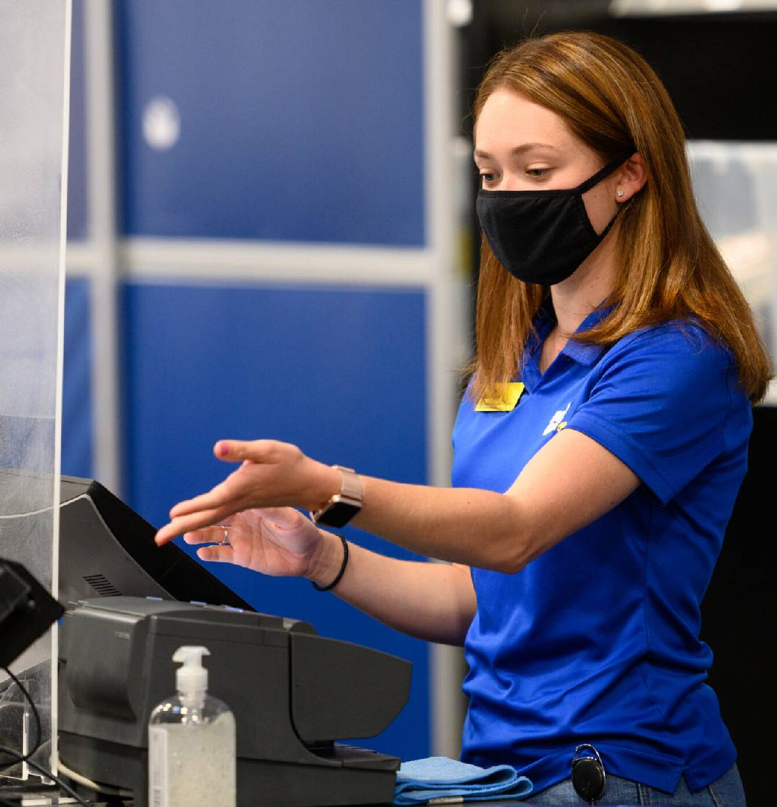
Service Warranty
Sold separately
Warranty revenue recognized evenly over time
Essentially “straight-line” revenue recognition
Warranty expenses recognized as incurred
Do NOT estimate a warranty expense and liability at the point of sale!!!

Slide 16
Service Warranty
When two-year service warranty is sold, record unearned revenue:
Cash (B-A) 100 Unearned Revenue (B-L) 100
If a claim is made, recognize expense at that point in time:
Warranty expense (I-E) 35
Asset/Liability used to fulfill claim (B-A or B-L) 35
As time goes on, record ALL revenue on a straight-line basis:
Unearned Revenue (B-L) 50
Warranty Revenue (I-R) 50

Slide 17
Go to handout…
Problems #2 & #3

Slide 18
Contingencies

Slide 19
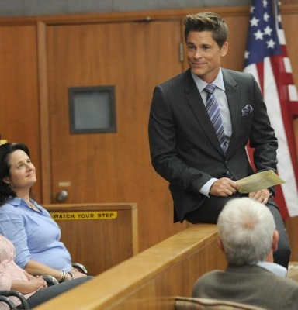
Contingencies
A loss contingency (contingent liability) is potential obligation that depends on future events → uncertainty
Examples: Pending lawsuit, warranties, environmental remediation
If recognized, increase a liability on balance sheet & Loss / Expense on Income Statement
APPLICATION OF THE CONSERVATISM PRINCIPLE!!!

Slide 20
Contingencies
A gain contingency is a claim to assets that a company may get depending on future events → uncertainty
Examples: Pending lawsuit, receipt of future donations, refunds from tax disputes
Disclosure in footnotes when there is high probability
Never recognize gain contingency
Remember the “Conservatism Principle”

Slide 21
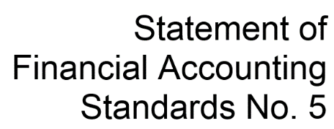

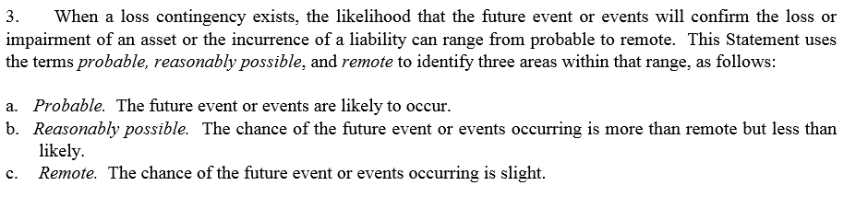
Accounting for Contingent Liabilities

Slide 22
Recording Contingent Liabilities
Two factors affect whether a loss contingency must be accrued (reported as a liability):
Probability: How likely is the event? If “more likely than not,” it’s probable.
Amount: Can the loss be estimated?
 | Probability of future sacrifice
 | Probable | Reasonably Possible | Remote
Amount can be estimated | Record liability and loss | Disclose liability in the notes to the financial statements | No action
Amount cannot be estimated | Disclose liability in the notes to the financial statements | Disclose liability in the notes to the financial statements | No action

Slide 23
Litigation Claims
Common disclosure for corporations
Key factors to determine if probable:
Progress of the case in court
Views of legal counsel as to the probability of loss
Prior experience with similar cases
Management’s intended response to the lawsuit
General Rule of Thumb: Record liability when Losing the case becomes “more likely than not.”
ANYTHING >50%! 50% + a grain of sand on the scale!
This is when we say the outcome is “probable”

Slide 24
Closing Thoughts
Gift card sales create a liability. Recognize breakage revenue ratably (based on collected vs expected) * if the state allows you to keep it.
Warranties:
Product: Expense and liability up front
Service: Unearned revenue up front, expenses as incurred, revenue over time
Contingencies
Never recognize a gain contingency
Recognize a loss contingency when probable and estimable

Slide 25
Find YOUR Missing Money
https://www.missingmoney.com/

